Slide 1
Water4Cities Internship Log
Edward Linton

Slide 2
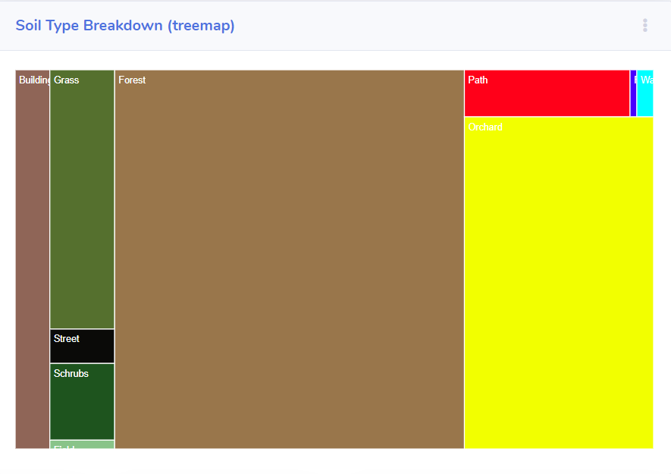
Treemap

Slide 3
Treemap Implementation
I was provided with a small amount of d3 code to introduce me into the world of treemaps. From here I did quite a bit of research into how to resize the components, set the colours, update on selection of an area of the map, etc. Originally I used if-else statements to capture how much of each land use was being used. However, I found I could make this more efficient by utilising the ‘eval’ function to use a variable name as a value.
On the next slide are snippets of code with descriptions

Slide 4
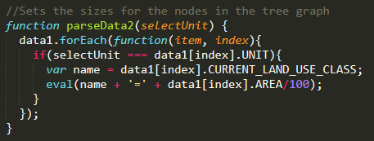
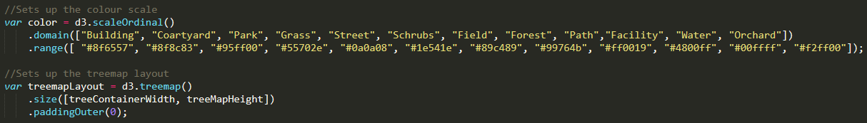
Treemap Implementation
This function parses the data whenever a user clicks on the map, checking to see what the land use proportions are in that sector and setting the area based upon that.
This sets up the canvas for the treemap, setting the colour for each of the different land types and setting up the container for the treemap itself

Slide 5
Treemap Implementation
This isn’t the whole line but summarises the idea nicely. Essentially this is just defining the data structure of the treemap, setting the different land types as children nodes.

Slide 6
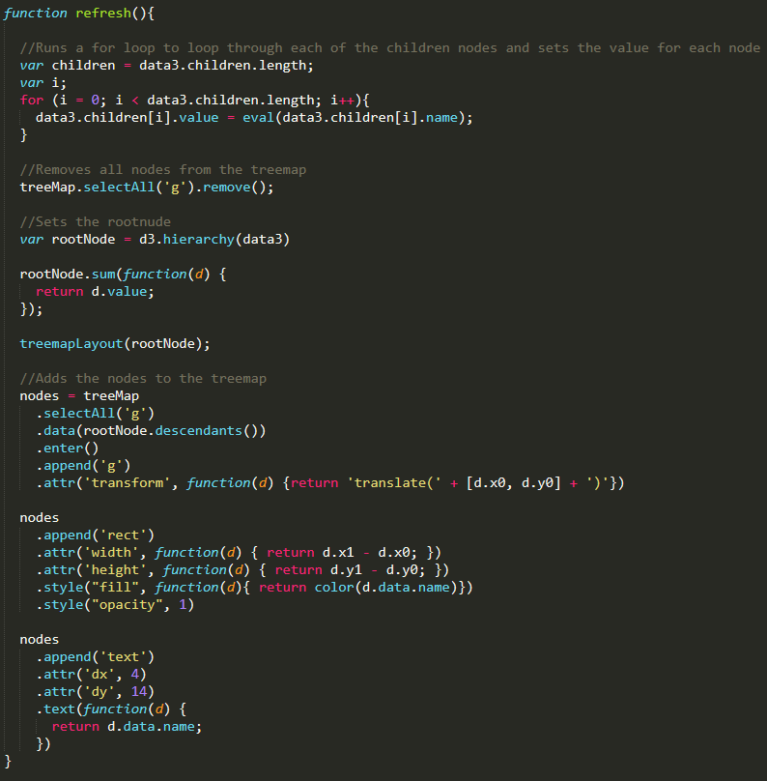
Treemap Implementation
This function dealt with the size of the nodes every time the user clicks a different section on the map. As previously mentioned, this started out using if else statements but once I discovered the eval function I managed to condense around 10 lines into 1.
The rest of the function writes the nodes to the treemap at their specified size/place. The whole process was a lot more intuitive than I would have thought, and while d3 took some reading up on I managed to pick it up at a reasonable pace.

Slide 7
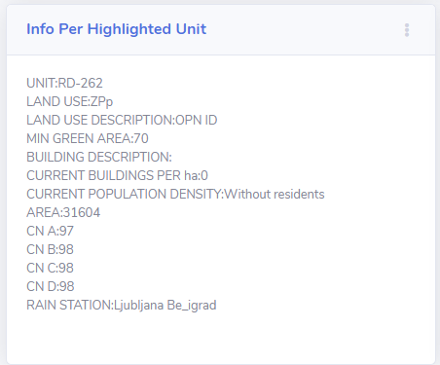
Info Per Highlighted Unit

Slide 8
Info Per Highlighted Unit Implementation
This was the easiest section of the project to wrap my head around as in theory it was simply a matter of taking each of the values in the csv file and setting the corresponding container to said value. I therefore used this unit as my introduction to d3, learning how the syntax works and the documentation I needed to read.
Upon revisiting the code I believe I could improve the efficiency, however for the time being it serves it’s purpose.

Slide 9
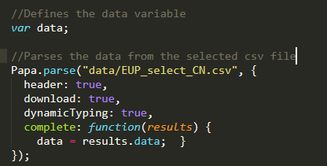
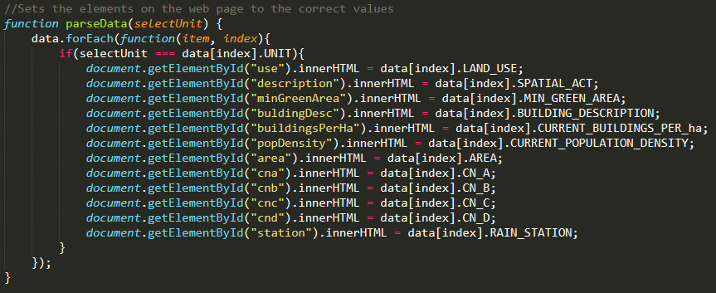
Info Per Highlighted Unit Implementation
This part of the script parses the data from the provided csv file, importing it into the data variable to make it easier to manipulate
This runs through each of the required fields and sets the value to that taken from the csv file. Upon looking at it, there is likely a simpler and more efficient way to do this. However, for the time being this is functional.

Slide 10
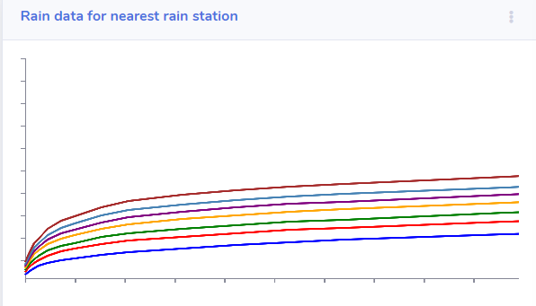
Line graph

Slide 11
Line Graph Implementation
This was the hardest part of the project for me to complete, and even now I am not happy with the finished product. It took a lot of reading to understand how d3 line graphs work, deciphering that co-ordinates are based in the top left of the frame and not the bottom left took longer than I would like to admit.
I have changed the way the code works so that it chooses the rain station based on the map selection, allowing for the expansion into a wider area. There would need to be a change in the back end for this, however, as I created a new csv file to take the data from and so this would need to be duplicated for any new rain stations.

Slide 12
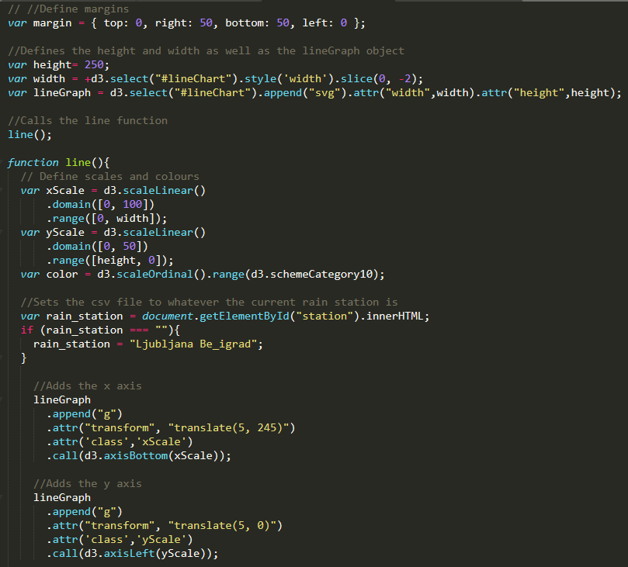
Line Graph Representation
This section of code sets up the line graph, setting the size of the axis, the colour of the lines and which rain station to pull the data from. There is still a large issue with this and that is that the line graph doesn’t fit to the data correctly. I have spent hours reading around the subject and trying different implementations but I cannot work out why this is happening. The Y axis always seems to be to long and the X axis doesn’t seem to show all of the data.
I believe I could eventually come up with a solution to the problem, but I would perhaps need to source help from elsewhere.

Slide 13
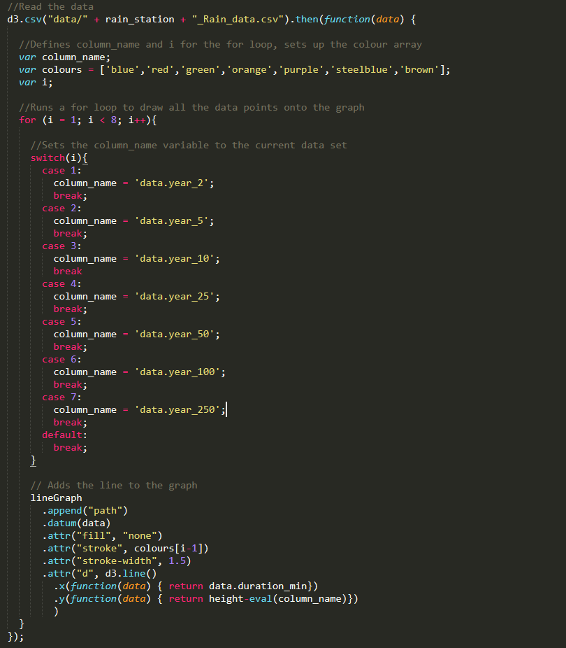
Line Graph Representation
This function reads in the data from the designated CSV file (defined earlier by the map click), sets up the colours for the different data lines and then plots the points. A switch statement is used to separate out the data, and while this works I believe it could be made more efficient.
The lines are added to the graph separately, using the .attr function of the lineGraph variable. When I first started this solution, the column_name variable was defined by using if else statements. However, I managed to condense this into one line by using the eval function.

Slide 14
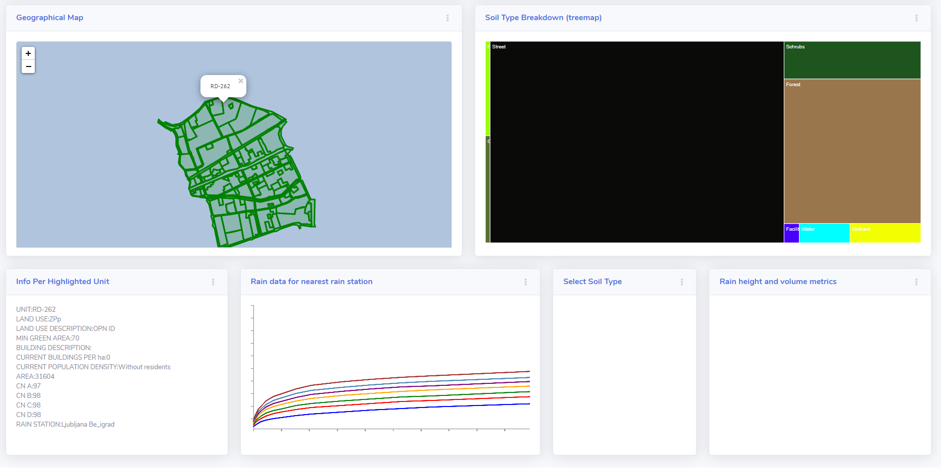
Conclusion

Slide 15
Conclusion
Overall, I am happy with the work I have completed on this project. For my first ‘industry’ web development project, I believe I have performed to the best of my ability. I have gained valuable experience on what it is like to work with a framework I am not familiar with, learning as I go by using documentation and efficient googling.
There are a couple of bugs in my code, and a lot of it is not as efficient as it could be. However, for my first experience into the industry I am satisfied with what I have accomplished (especially given the disruption Covid-19 has caused). The project has given me insight into the world of front-end development and caused me to want to pursue this further.

